Slide 1


Customer Churn Prediction
SUPERVISED by:
DR.KIRANDEEP SINGH
PRESENTED BY:
TEAM RANDOM.(P)

Slide 2
TEAM MEMBERS
ROLL NUMBER | MEMBER NAME
PRACHI SINGLA | 2210990662
PRATISTHA NEGI | 2210990678
PUNAL | 2210990690

Slide 3
What is Customer Churn?
Customer churn, or customer attrition, signifies when customers cease doing business with a company.
It is critical for businesses as it directly affects revenue and profitability.
It can stem from various factors including dissatisfaction with the product or service, better offers from competitors, changes in customer needs or circumstances, or poor customer experiences.
Precise measurement of churn involves tracking the number or percentage of customers who have stopped using a company's product or service within a specific time frame, typically monthly or annually.
This data is crucial for businesses to understand customer behavior, identify areas for improvement, and implement strategies to reduce churn and retain valuable customers.

Slide 4
Objectives
The objective of studying customer churn typically revolves around several key goals:
1. Identifying Risk Factors : Understanding the factors that contribute to customer churn helps businesses identify potential risk factors that may lead to customer attrition.
2. Predictive Analysis : Analyzing historical data and customer behavior patterns allows businesses to develop predictive models that forecast the likelihood of churn for individual customers..
3. Maximizing Customer Lifetime Value (CLV) : Customer churn directly impacts a business's revenue and profitability. By reducing churn rates and extending customer lifetime value, businesses can maximize the return on their investment in customer acquisition and retention efforts.
4. Improving Customer Experience : Addressing the root causes of churn often involves improving the overall customer experience. By listening to customer feedback, addressing pain points, and delivering exceptional service, businesses can enhance customer satisfaction and loyalty, leading to lower churn rates and increased profitability.

Slide 5
Introduction
Competitive Business Landscape: In today's highly competitive business environment, customer retention is essential for sustainable growth.
Significance of Customer Churn: Customer churn, which denotes the loss of customers over a specific period, is a critical metric. It not only affects revenue streams but also undermines brand loyalty and market competitiveness.
Report Overview: This report delves into the multifaceted phenomenon of customer churn, examining its implications, underlying causes, and strategic implications for businesses across industries.
Understanding Churn: By comprehensively understanding customer churn and its impact on organizational performance, companies can proactively implement measures to mitigate churn.
Fostering Loyalty: Strategies aimed at mitigating churn include fostering customer loyalty, enhancing customer experiences, and offering competitive products or services.
Long-term Profitability: Through effective churn management strategies, businesses can drive long-term profitability and sustainable growth.

Slide 6
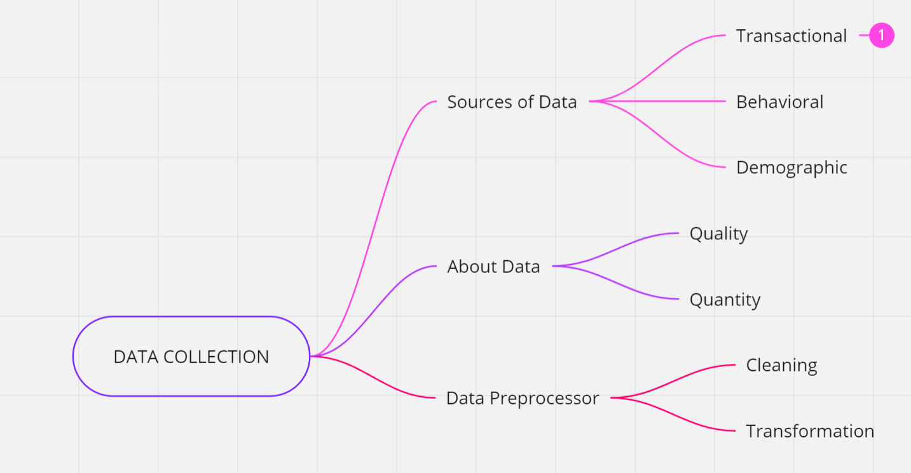

Slide 7
Source Of Data : https://www.kaggle.com/code/simgeerek/churn-prediction-using-machine-learning
Transactional Data:
Transactional data in banking includes records of customer financial activities and interactions with banking services.
Examples:
Deposits and withdrawals
Loan applications and repayments
Credit card transactions
Importance: Transactional data provides insights into individual banking behaviors, such as account usage patterns and financial stability indicators, which are crucial for predicting churn.

Slide 8
Behavioral Data:
Behavioral data in banking refers to customer actions and engagements with banking products and services.
Examples:
Online banking logins and activity
ATM withdrawals and branch visits
Bill payments and fund transfers
Importance: Behavioral data helps identify customer preferences, satisfaction levels, and potential indicators of dissatisfaction or churn, allowing banks to proactively address issues and retain customers
Demographic Data:
Demographic data in banking encompasses socio-economic and personal characteristics of customers.
Examples:
Age, gender, marital status
Income level and employment status
Residential location
Importance: Demographic data enables banks to segment customers based on their unique needs and preferences, allowing for targeted marketing campaigns and personalized retention strategies tailored to different customer segments.

Slide 9
Data Preprocessor
CLEANING
Data Validation: The first step in cleaning customer churn data is to validate its integrity. This involves checking for any inconsistencies, errors, or anomalies in the data. For example, ensuring that all required fields are present, checking for data types, and verifying the accuracy of numerical values.
Handling Missing Data: Customer churn data often contains missing values due to various reasons such as data entry errors or incomplete records. It's crucial to address these missing values to prevent them from affecting the accuracy of churn predictions.
Dealing with Outliers: Outliers in customer churn data can skew analysis and model performance. Identifying and handling outliers is essential to ensure the reliability of churn prediction models. Depending on the nature of the outliers and the analysis goals, outliers can be removed, transformed, or treated separately.
Normalization and Standardization: Customer churn datasets often contain features with varying scales. Normalizing or standardizing numerical features ensures that they have a comparable scale, which is important for many machine learning algorithms to perform effectively.

Slide 10
TRANSFORMATION
Feature Engineering:
Identify and create new features that capture key aspects of customer behavior, such as average purchase frequency, total spending, or recency of interactions.
Derive features that reflect customer engagement levels, such as the number of logins, clicks, or interactions with customer support.
Handling Categorical Variables:
Encode categorical variables into numerical representations using techniques like one-hot encoding or label encoding.
Ensure that categorical variables are properly transformed to enable inclusion in machine learning models.
Data Balancing:
Address class imbalance by applying techniques such as oversampling, undersampling, or using algorithms that are robust to class imbalance.
Ensure that the dataset contains a balanced representation of churners and non-churners to prevent bias in model predictions.

Slide 11
EDA(Exploratory Data Analysis)
1. Data Understanding:
- Familiarize yourself with the dataset's structure, including the number of rows and columns, data types, and any missing values.
- Understand the meaning and context of each feature/column in the dataset.
2. Data Visualization:
- Plot histograms or boxplots to visualize the distribution of numerical features and identify outliers.
- Use bar charts or pie charts to visualize the distribution of categorical features.
- Create correlation matrices or heatmaps to understand relationships between features and the target variable (churn).
3. Feature Analysis:
- Compare the distribution of features between churned and non-churned customers to identify patterns or differences.
- Analyze the impact of individual features on churn using visualizations like scatter plots (for numerical features) or stacked bar charts (for categorical features).
4. Handling Missing Values and Outliers:
- Identify and decide on the appropriate strategy for handling missing values (imputation, deletion, etc.).
- Evaluate the impact of outliers on the analysis and consider appropriate methods for handling them.
9

Slide 12
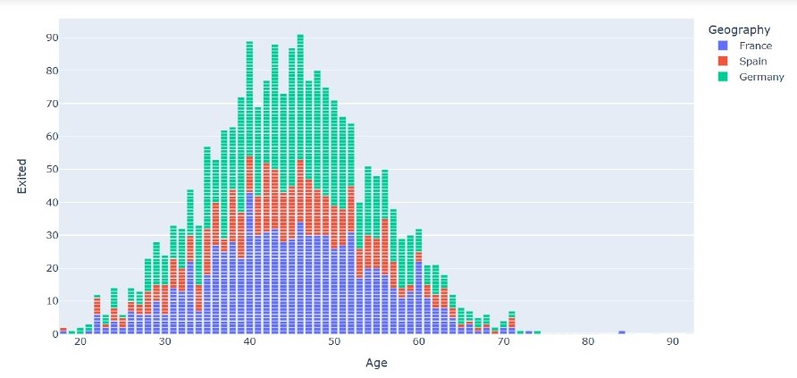
1. AGE VS EXITED
The graph displays a population pyramid, which is a type of age-sex pyramid used to visualize the age and gender distribution of a population. In this case, it shows the age distribution for France, Spain, and Germany.
The x-axis : age groups, ranging from around 20 to 90 years old.
The y-axis : share of the population within each age group.
The bars are divided into three colors - green for France, red for Spain, and blue for Germany.
The pyramid shape arises because younger age groups tend to have a larger population share, which tapers off for older ages.
By comparing the three countries' bar lengths, we can observe differences in their age distributions:
France appears to have a slightly younger population skew compared to Spain and Germany, which show broader bulges around middle-age groups.

Slide 13
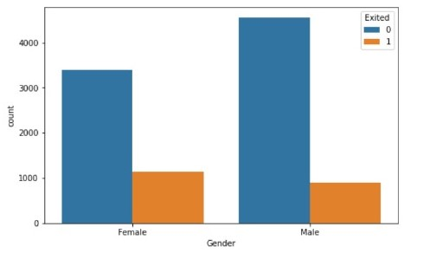
2.GENDER VS EXITED
Based on the graph, the following inferences can be drawn:
1. The graph displays the counts or frequencies of two categories - "Exited" (orange bars) and not "Exited" (blue bars) - across two genders, Female and Male.
2. For both genders, the count of individuals who have not "Exited" (blue bars) is significantly higher than the count of those who have "Exited" (orange bars).
3. Among females, the count of non-exited individuals is lower compared to males, while the count of exited females is slightly higher than exited males.
4. The data suggests that the likelihood of exiting or churning may be slightly higher for females compared to males in this particular dataset.
5. However, it's important to note that the graph alone does not provide enough context or information to determine the specific reasons or factors contributing to the observed differences between genders.

Slide 14
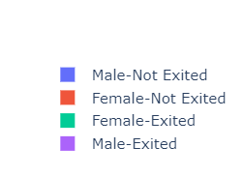
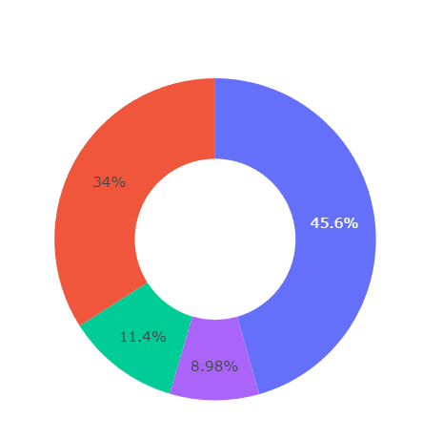
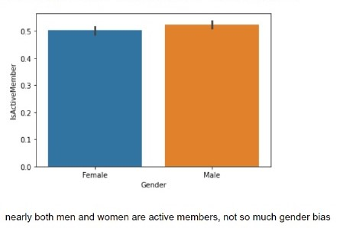
ANOTHER GENDER BASED GRAPHS

Slide 15
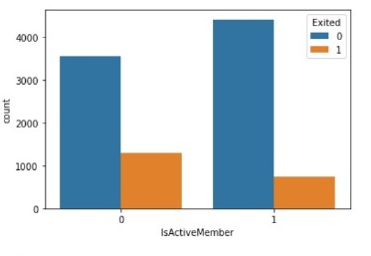
3. COUNT VS ACTIVE MEMBER
Based on the graph inferences can be drawn:
1. High active membership : lower exit or churn rates.
2. Low or inactive membership : higher exit or churn rates.
3. When “Is Active Member“(active bar) is 1 .the count of non-exited individuals (blue bar) is significantly higher than the count of exited individuals (orange bar).
4. When “Is Active Member" (inactive member) is 0, the count of exited individuals (orange bar) is higher than the count of non-exited individuals (blue bar).
5. Active membership appears to be a crucial factor in retaining individuals, whether they are customers, subscribers, or members of an organization.
6. Other factors influencing exit or retention rates may not be captured in this specific graph.

Slide 16
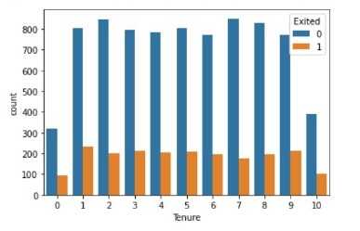
2. COUNT VS TENURE
Based on the data shown, a few inferences can be drawn:
1. The blue category has significantly higher counts than the orange category across most tenure values.
2. For both categories, the counts tend to decrease as the tenure value increases, with some fluctuations.
3. The orange category shows a notable increase in count at tenure value 9, while the blue category remains relatively stable at that point.
4. The title "Exited" and the legend with values 0 and 1 suggest that the two categories might represent whether an employee or customer has exited (1) or not (0) based on their tenure.
The graph alone provides insights into the relative counts and patterns across tenure values, but the exact inference would depend on the domain and variables being analyzed.

Slide 17
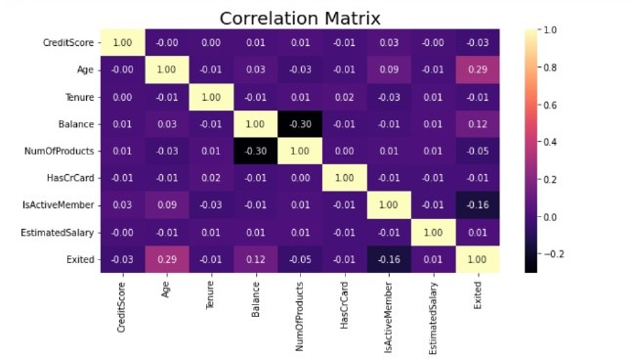
Techniques for Feature Selection
CORRELATION ANALYSIS:
Credit Score and Age have a perfect negative correlation of -1.0 and -1.0 respectively with themselves, as expected. Age has a moderate positive correlation of 0.29 with Exited. Balance has a weak positive correlation of 0.12 with Exited. Num Of Products has a very weak negative correlation of -0.05 with Exited. Has Cr Card has an extremely weak negative correlation of -0.01 with Exited. Is Active Member has a moderate negative correlation of -0.16 with Exited. Estimated Salary has a very weak positive correlation of 0.01 with Exited. Notable correlations between independent variables: Age and Tenure: -0.01 (very weak negative) Age and Balance: 0.03 (very weak positive) Balance and Num Of Products: -0.30 (moderate negative)

Slide 18
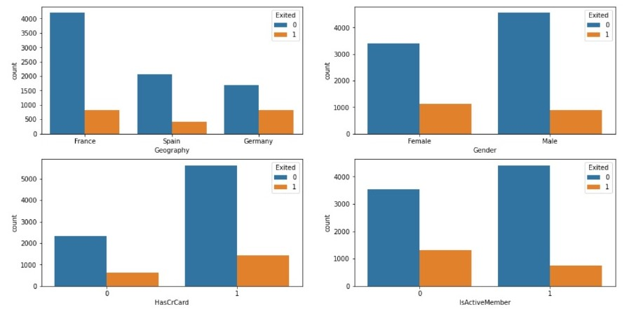
Based on the set of graphs shown, the following inferences can be made:
1. The graphs display the counts or frequencies of two categories - "Exited" (orange bars) and not "Exited" (blue bars) - across different variables or features.
2. Geography: Among the countries shown (France, Spain, Germany), France has the highest count of non-exited individuals, while Spain has the lowest.
3. Gender: For both genders (Female and Male), the count of non-exited individuals (blue bars) is higher than the count of exited individuals (orange bars). However, the gap between non-exited and exited is smaller for females compared to males.
4. HasCrCard: Individuals who have a credit card (HasCrCard = 1) have a higher count of non-exited individuals compared to those who do not have a credit card (HasCrCard = 0).
5. Is Active Member: Similar to the HasCrCard feature, individuals who are active members (IsActiveMember = 1) have a significantly higher count of non-exited individuals compared to those who are not active members (IsActiveMember = 0).
6. The graphs suggest that factors such as geography, gender, credit card ownership, and active membership status may influence the likelihood of individuals exiting or churning.
Overall, these graphs provide insights into potential relationships between various features and the likelihood of individuals exiting or staying.

Slide 19
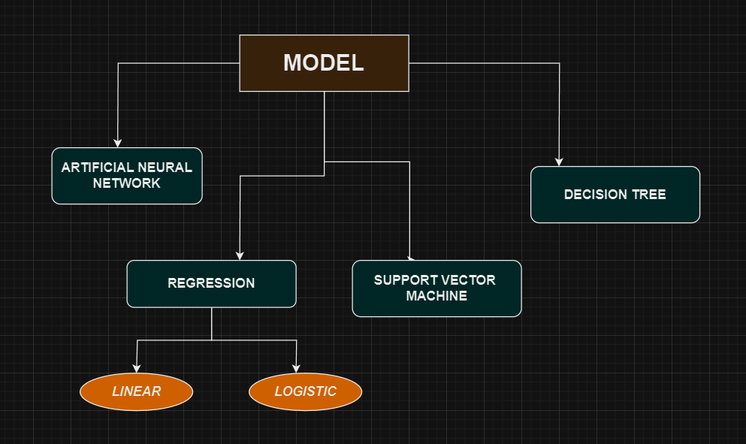
MODEL SELECTION
K-NEAREST NEIGHBOUR (KNN)
RANDOM FORESTS

Slide 20
EVALUATION METRICS
Precision: The fraction of instances predicted as positive that are actually positive. It measures the exactness of the positive predictions made.
Recall: The fraction of actual positive instances that were correctly predicted as positive. It measures how well the model identifies all positive instances.
F1-score: The harmonic mean of precision and recall, providing a balanced measure that combines both metrics into one score.
Support: The number of instances of each class in the dataset.
Accuracy: The fraction of instances that were correctly classified by the model.
Macro avg: The unweighted mean of the metric values across all classes.
Weighted avg: The mean of the metric values weighted by the frequency/support of each class. It accounts for class imbalance.

Slide 21
1.Regression
Regression techniques can be employed to predict customer churn. Customer churn refers to the phenomenon where customers discontinue their relationship with a company or service. Predicting churn is crucial for businesses as it allows them to take proactive measures to retain customers.
LINEAR REGRESSION:
Using linear regression for customer churn prediction may not be the best choice for several reasons:
Binary Outcome: Customer churn prediction is typically a binary classification problem where the outcome is either churned or not churned. Linear regression, however, is designed for continuous outcomes and may not be suitable for predicting binary outcomes directly.
Outliers and Skewed Data: Linear regression is sensitive to outliers and skewed data. In customer churn prediction, you might have imbalanced classes or outliers in the dataset, which can negatively impact the performance of linear regression.

Slide 22
LOGISTIC REGRESSION
Logistic regression is a commonly used technique for customer churn prediction, and it's well-suited for binary classification.
1. Target Variable:
- Identify the target variable, which is whether a customer churns or not (usually represented as a binary outcome: 1 for churn, 0 for non-churn).
2. Data Preparation:
- Split the data into training and testing sets to evaluate model performance.
- Handle missing values and outliers appropriately, either through imputation or removal.
3. Model Building:
- Fit a linear regression model to the training data, treating churn as the dependent variable and the selected features as independent variables.
- The linear regression model estimates the relationship between the predictors and the probability of churn.
4. Model Evaluation:
- Consider using techniques like cross-validation to assess the model's robustness and generalization ability.

Slide 23
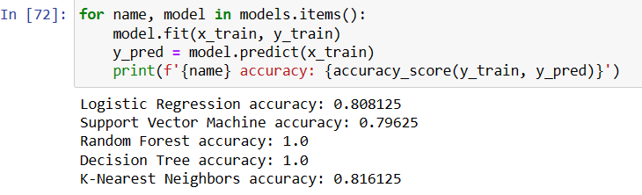
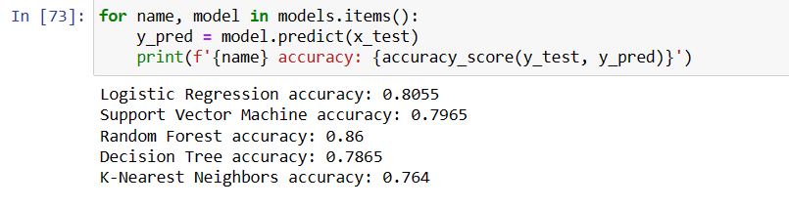


Model Accuracy

Slide 24
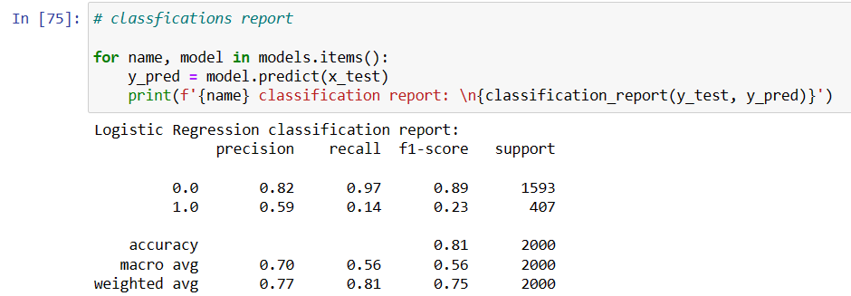
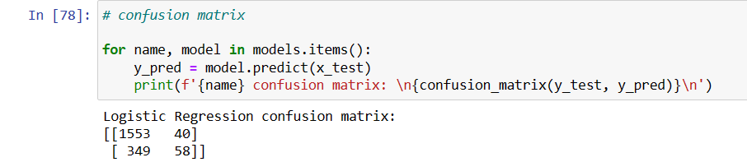
Confusion Matrix

Slide 25
SUPPORT VECTOR MACHINE
It's based on the concept of maximizing the margin, which represents the distance between the hyperplane and the nearest data points (support vectors) of each class.
Binary Classification:
SVM is applied to classify customers into churners and non-churners, treating churn as the positive class (1) and non-churn as the negative class (0).
Data Preprocessing:
Scale features to ensure they have similar ranges, as SVM is sensitive to feature scales.
Handle missing values and encode categorical variables if necessary.
Handling Imbalanced Data:
Address class imbalance by using techniques like oversampling (e.g., SMOTE), undersampling, or adjusting class weights to prevent bias towards the majority class.

Slide 26
Model Accuracy

Slide 27
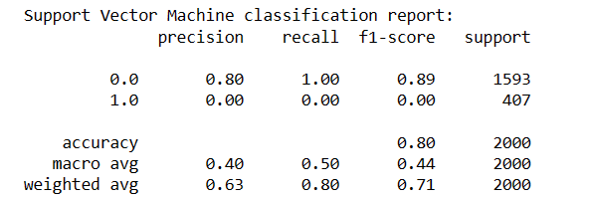

Confusion Matrix

Slide 28
DECISION TREE
It recursively splits the dataset into subsets based on the most significant attribute at each node, forming a tree-like structure of decision rules.
Feature Importance:
Decision trees provide insights into the most important features for predicting churn by examining feature importance scores, which indicate the predictive power of each attribute.
Segmentation:
Decision trees segment customers into homogeneous groups based on their characteristics and behavior, identifying subsets of customers with higher churn probabilities.
Handling Non-linearity:
Decision trees can capture non-linear relationships between features and churn, allowing for flexible modeling of complex patterns in customer behavior.
Customer Path Analysis:
Decision trees can be used to trace individual customer paths through the tree, revealing the sequence of factors that contribute to churn for each customer.

Slide 29
Model Accuracy

Slide 30
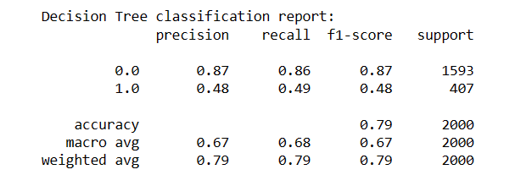

Confusion Matrix

Slide 31
RANDOM FOREST
Random Forest leverages the concept of bagging (Bootstrap Aggregating) to create diverse subsets of the training data for each tree.
Each decision tree in the Random Forest is trained independently, making the model robust to noise and variance.
Improved Predictive Accuracy:
Random Forest combines the predictions of multiple decision trees, resulting in higher predictive accuracy compared to individual decision trees.
Handling Non-linearity and Interactions:
Random Forest can capture complex non-linear relationships and interactions between features, enabling it to model intricate patterns in customer behavior associated with churn.
Ensemble Learning:
Random Forest is a type of ensemble learning method that combines the strengths of multiple decision trees, offering improved performance and stability over individual models.
Scalability and Parallelization:
Random Forest can be parallelized, allowing for efficient computation and scalability to large datasets, making it suitable for churn prediction in big data environments.

Slide 32

Model Accuracy

Slide 33
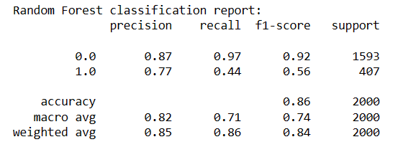

Confusion Matrix

Slide 34
K-NEAREST NEIGHBOUR
KNN is a non-parametric algorithm, meaning it doesn't make explicit assumptions about the underlying data distribution.
It relies on a distance metric (e.g., Euclidean distance) to measure the similarity between data points and identify nearest neighbors.
Proximity-based Classification:
KNN predicts churn for a customer by considering the churn status of its K nearest neighbors, assuming that similar customers have similar churn behaviors.
Simple Implementation:
KNN is easy to understand and implement, making it suitable for quick prototyping and experimentation in churn prediction tasks.
Impact of K Parameter:
The choice of the K parameter influences the model's performance and generalization ability, with smaller values potentially leading to overfitting and larger values resulting in underfitting.
Distance Metric Selection:
The choice of distance metric (e.g., Euclidean, Manhattan, etc.) affects how KNN measures similarity between data points and can impact model performance.

Slide 35
Model Accuracy

Slide 36
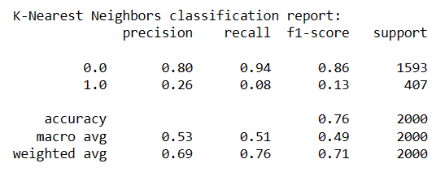

Confusion Matrix

Slide 37
KFOLD CROSS-VALIDATION
k-fold cross-validation is a resampling technique used to assess the performance and generalization ability of a machine learning model. The dataset is divided into k subsets (folds) of approximately equal size.
k-fold cross-validation provides a more reliable estimate of the model's performance by reducing the variance associated with a single train-test split.
It helps identify the model that achieves the best average performance across different subsets of the data, leading to more informed model selection decisions.
k-fold cross-validation helps strike a balance between bias and variance in model evaluation.
Performance metrics such as accuracy, precision, recall, F1-score, or area under the ROC curve (AUC-ROC) obtained from each fold are averaged to obtain a single aggregate metric representing the model's overall performance.

Slide 38
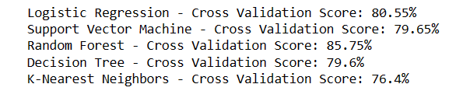
IMPLEMENTATION

Slide 39
CONCLUSION
BEST PERFORMING MODEL:
- Random Forest - Cross Validation Score: 85.75%
The Random Forest algorithm achieved the highest cross-validation score of 85.75%, indicating that it performed the best among the evaluated models in terms of accurately predicting the target variable on unseen data. Random Forest is an ensemble learning method that combines multiple decision trees to improve predictive accuracy and reduce overfitting.
WORST PERFORMING MODEL:
- K-Nearest Neighbors - Cross Validation Score: 76.4%
The K-Nearest Neighbors (KNN) algorithm had the lowest cross-validation score of 76.4%, making it the worst-performing model in this comparison. KNN is a non-parametric method that classifies instances based on their similarity to the nearest neighbors in the training data. Its lower performance could be due to factors such as the choice of distance metric, the value of k (number of neighbors), or the presence of noisy or irrelevant features in the data.

Slide 40
OTHER MODELS:
- Logistic Regression - Cross Validation Score: 80.55%
Logistic Regression, a popular statistical model for binary classification, achieved a cross-validation score of 80.55%, performing better than SVM and Decision Tree but worse than Random Forest.
- Support Vector Machine (SVM) - Cross Validation Score: 79.65%
The SVM model, which constructs hyperplanes in high-dimensional spaces for classification or regression, had a cross-validation score of 79.65%, slightly outperforming the Decision Tree but underperforming compared to Logistic Regression and Random Forest.
- Decision Tree - Cross Validation Score: 79.6%
The Decision Tree algorithm, which recursively partitions the data based on feature values, achieved a cross-validation score of 79.6%, similar to SVM but lower than the other models.

Slide 41

THE END

